Slide 1
ECEN 150 Circuit Analysis I
AC Power

Slide 2
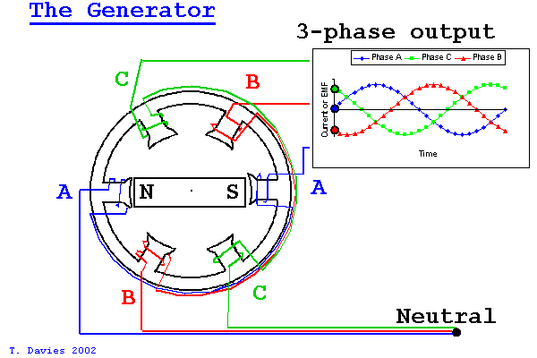
AC Power Generation
AC → Alternating Current. Current alternates (Reverses) direction of flow, repeating the pattern over and over.
Sinusoidal voltages and currents are produced by ac generators and electronic oscillators.
AC implies sinusoids (sines and cosines) for voltage and current.
Most electrical energy is is generated as Three-Phase AC.
Three-phase AC power is generated by a single
rotating magnet surrounded by 6 coils aligned
perfectly so that each phase will create a sinusoid
120° off from each other.
The resulting instantaneous power is never zero,
which is preferred for large AC motors.
Three-phase Delta configuration (3 wires) actually
requires about 25% less conductor volume than single
phase (2 wires) for the same power loss. Hence
three-phase delta is the preferred configuration for
long distance power distribution.

Slide 3
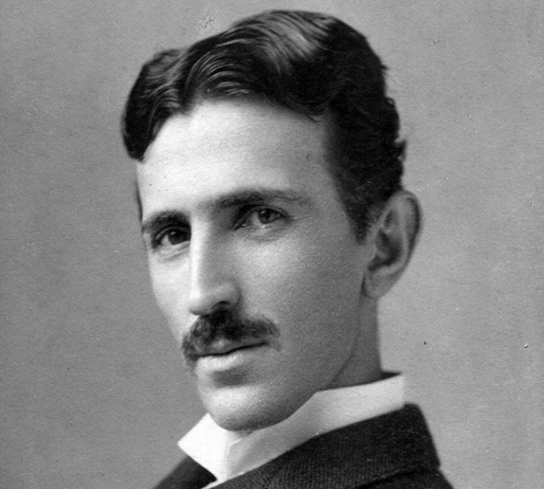
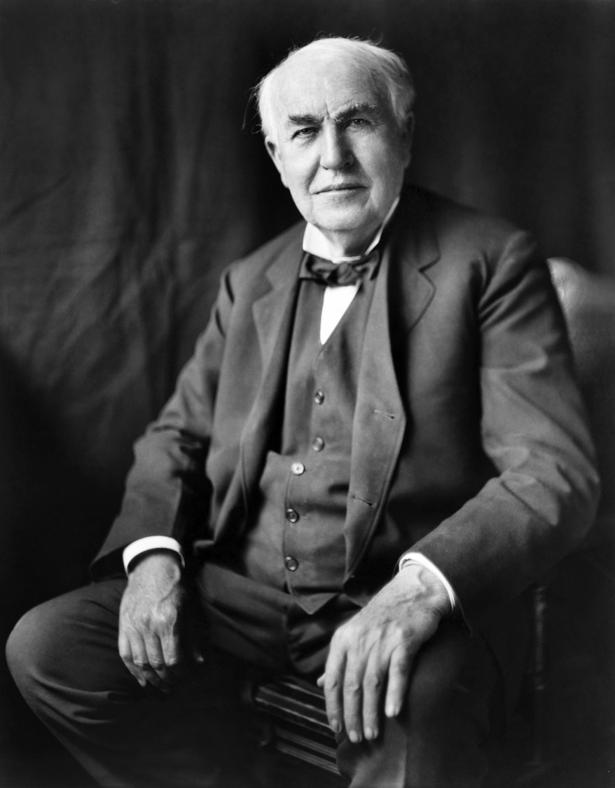
Tesla and Edison
While Thomas Edison is known for several inventions
(including the light bulb), he was above all an astute businessman.
Nikola Tesla was just the opposite -- a prolific inventor who died
penniless.
When Tesla first moved to the U.S., he idolized Edison and got
a job working for him. However, they soon had a falling out and
Tesla quit.
An epic rivalry later developed between Edison and Tesla over alternating (AC) vs. direct current (DC). In the early days of electricity, Edison owned patents related to direct current and was a proponent of using that technology for transmitting electricity over large distances. However, alternating current, which Tesla invented, can easily be stepped up or down in voltage by means of a transformers and so has been the dominant technology for electrical transmission.
Sources of AC Electrical Energy → Turbines.
Sources of DC Electrical Energy → Batteries, solar panels.
Notes:
https://commons.wikimedia.org/wiki/File:Tesla_circa_1890.jpeg
https://www.goodfreephotos.com/people/thomas-edison-portrait.jpg.php

Slide 4
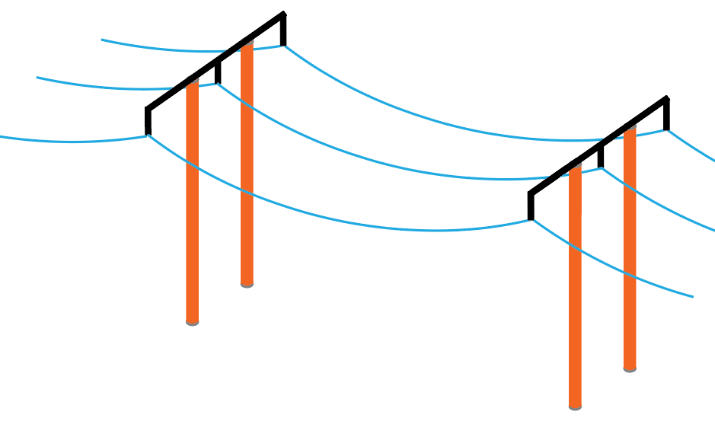
AC Power Distribution
Why is AC more efficient and economical for long distance power transmission than DC?
Transmission line power loss: p_{loss} = i²R_{loss}.
Hence, reducing current significantly reduces power
line loss.
So how do we reduce current for a given power?
Electrical power equals product of voltage and
current, i.e., p = vi.
Can use AC transformers to step up voltage, which
steps down current by the same factor for a given power.
What about p = v²/R?
High voltage on a transmission line does not translate into a large voltage drop across the low resistance lines.
So, high voltage transmission lines can transmit a given power for reduced power loss, because of reduced current.
Modern switching techniques can also be used to step up DC voltages while stepping down DC currents, whereas AC transformers have been doing this for the last 100 years.

Slide 5
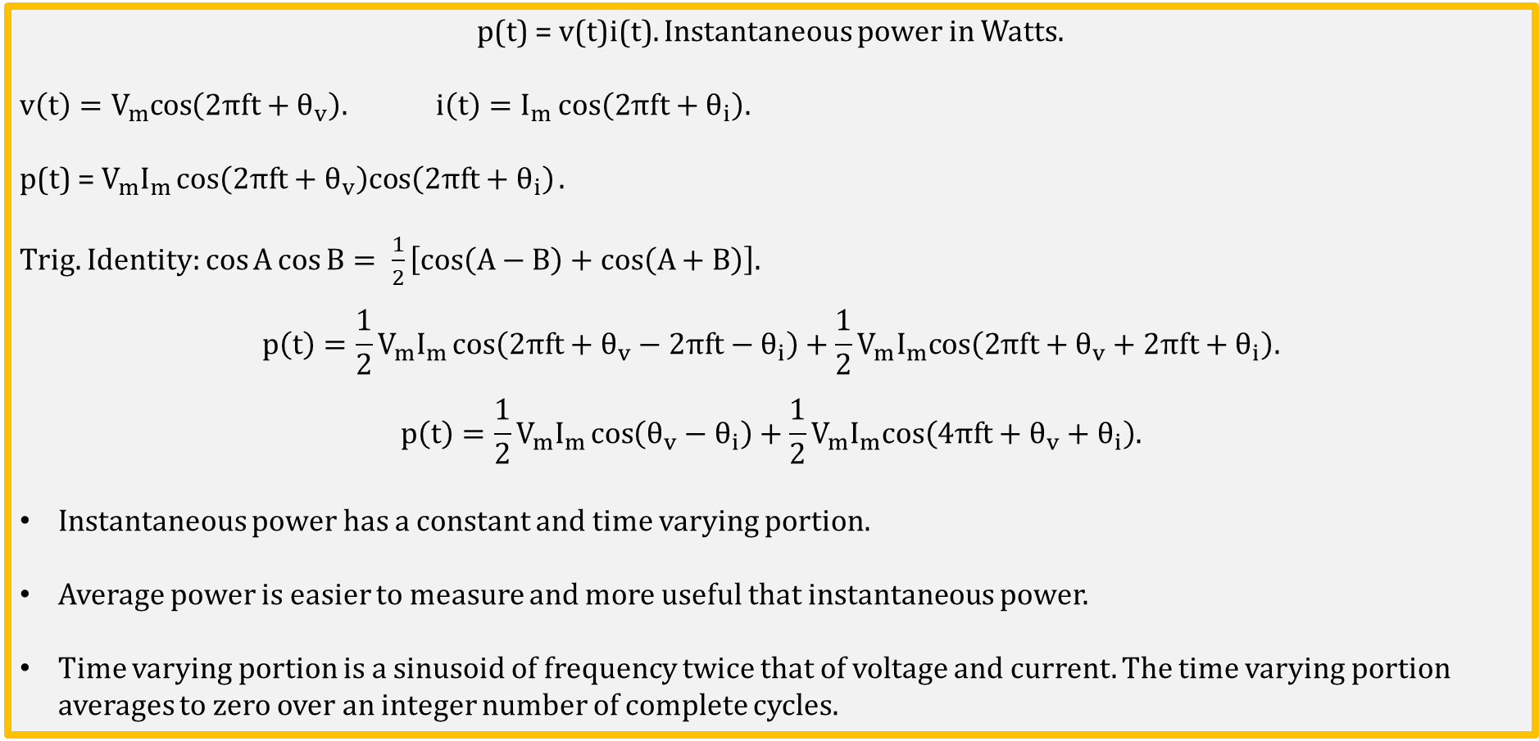
Instantaneous and Average Power
p(t) = v(t)i(t). Instantaneous power in Watts.
v$\left(t\right)=V_{m}cos\left(2πft+θ_{v}\right).$ i$\left(t\right)=I_{m}{cos\left(2πft+θ_{i}\right).}$
p(t) = $V_{m}I_{m}\cos\left(2πft+θ_{v}\right)cos\left(2πft+θ_{i}\right).$
Trig. Identity: $\cos{A}\cos{B}= \frac{1}{2}\left[cos\left(A−B\right)+cos\left(A+B\right)\right].$
$$p\left(t\right)=\frac{1}{2}V_{m}I_{m}\cos\left(2πft+θ_{v}−2πft−θ_{i}\right)+\frac{1}{2}V_{m}I_{m}cos\left(2πft+θ_{v}+2πft+θ_{i}\right).$$
$$p\left(t\right)=\frac{1}{2}V_{m}I_{m}\cos\left(θ_{v}−θ_{i}\right)+\frac{1}{2}V_{m}I_{m}cos\left(4πft+θ_{v}+θ_{i}\right).$$
Instantaneous power has a constant and time varying portion.
Average power is easier to measure and more useful that instantaneous power.
Time varying portion is a sinusoid of frequency twice that of voltage and current. The time varying portion averages to zero over an integer number of complete cycles.

Slide 6
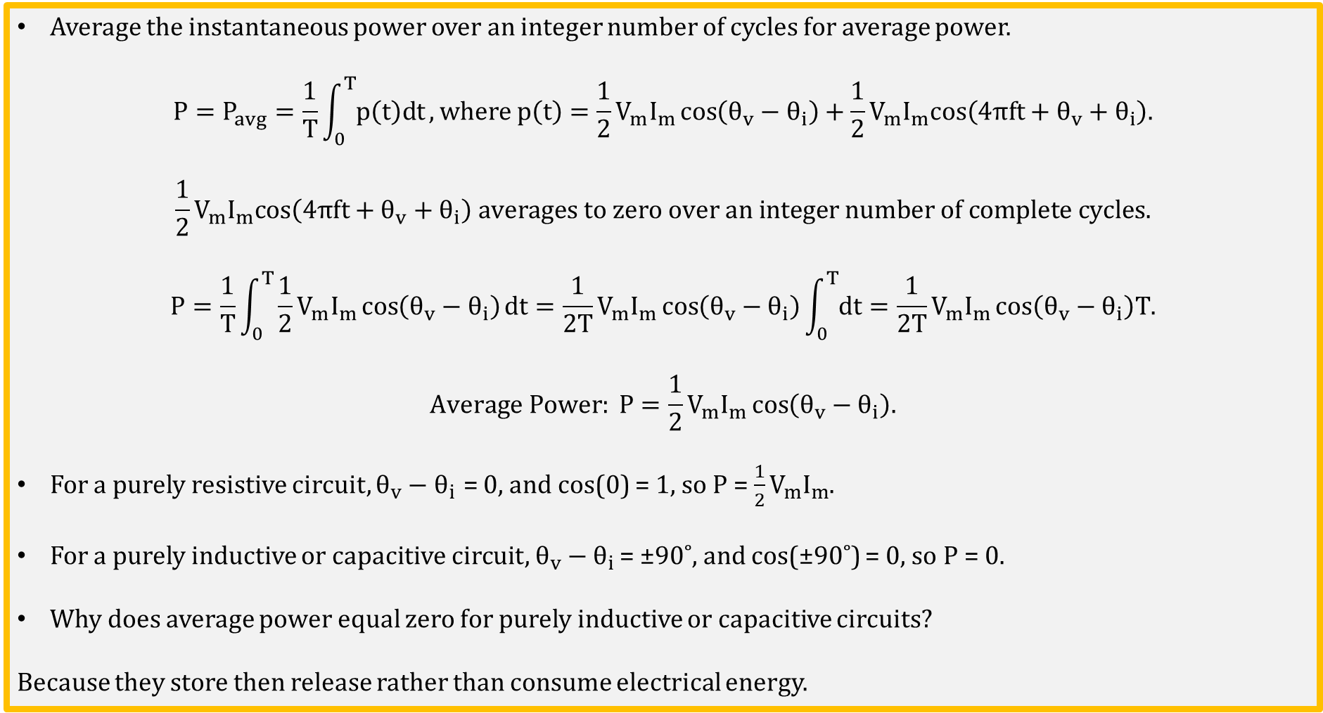
Average Power
Average the instantaneous power over an integer number of cycles for average power.
$$P=P_{avg}=\frac{1}{T}\int_{0}^{T}{p\left(t\right)dt}, where p\left(t\right)=\frac{1}{2}V_{m}I_{m}\cos\left(θ_{v}−θ_{i}\right)+\frac{1}{2}V_{m}I_{m}cos\left(4πft+θ_{v}+θ_{i}\right).$$
$$\frac{1}{2}V_{m}I_{m}cos\left(4πft+θ_{v}+θ_{i}\right) averages to zero over an integer number of complete cycles.$$
$$P=\frac{1}{T}\int_{0}^{T}{\frac{1}{2}V_{m}I_{m}\cos\left(θ_{v}−θ_{i}\right)dt=\frac{1}{2T}V_{m}I_{m}\cos\left(θ_{v}−θ_{i}\right)\int_{0}^{T}{dt}=\frac{1}{2T}V_{m}I_{m}\cos\left(θ_{v}−θ_{i}\right)T.}$$
$$Average Power: P=\frac{1}{2}V_{m}I_{m}\cos\left(θ_{v}−θ_{i}\right).$$
For a purely resistive circuit, $θ_{v}−θ_{i}$ = 0, and cos(0) = 1, so $P$= $\frac{1}{2}V_{m}I_{m}$.
For a purely inductive or capacitive circuit, $θ_{v}−θ_{i}$ = ±90˚, and cos(±90˚) = 0, so $P$= 0.
Why does average power equal zero for purely inductive or capacitive circuits?
Because they store then release rather than consume electrical energy.

Slide 7
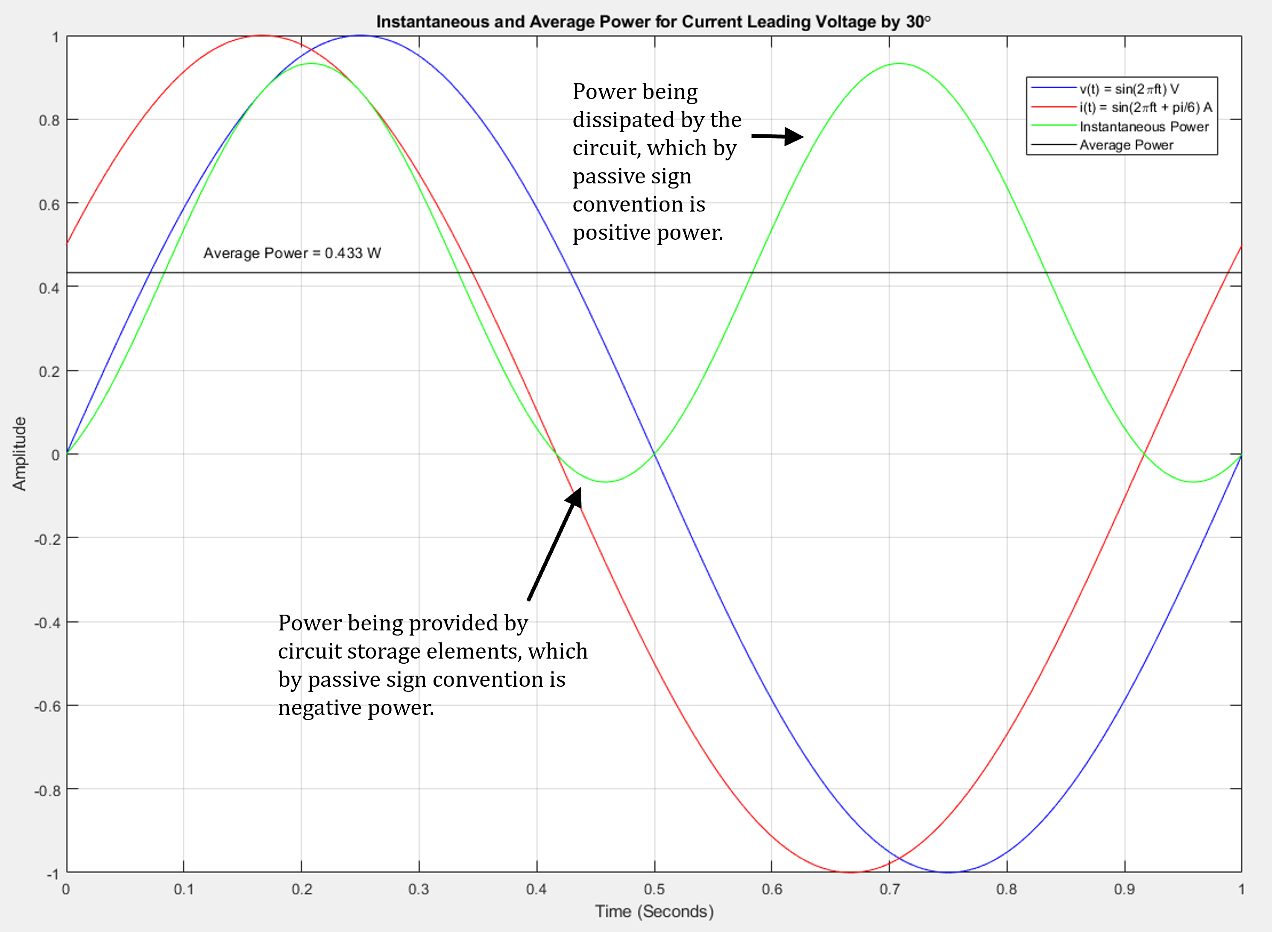
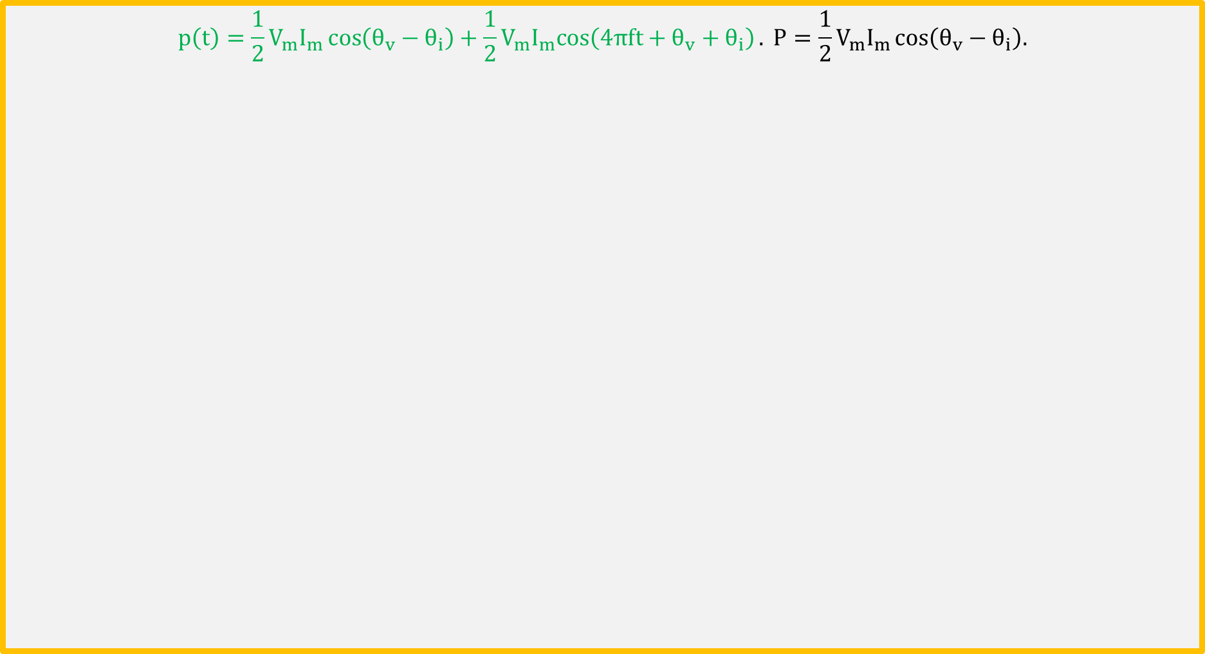
Instantaneous and Average Power (Continued)
$$p\left(t\right)=\frac{1}{2}V_{m}I_{m}\cos\left(θ_{v}−θ_{i}\right)+\frac{1}{2}V_{m}I_{m}cos\left(4πft+θ_{v}+θ_{i}\right). P=\frac{1}{2}V_{m}I_{m}\cos\left(θ_{v}−θ_{i}\right).$$

Slide 8
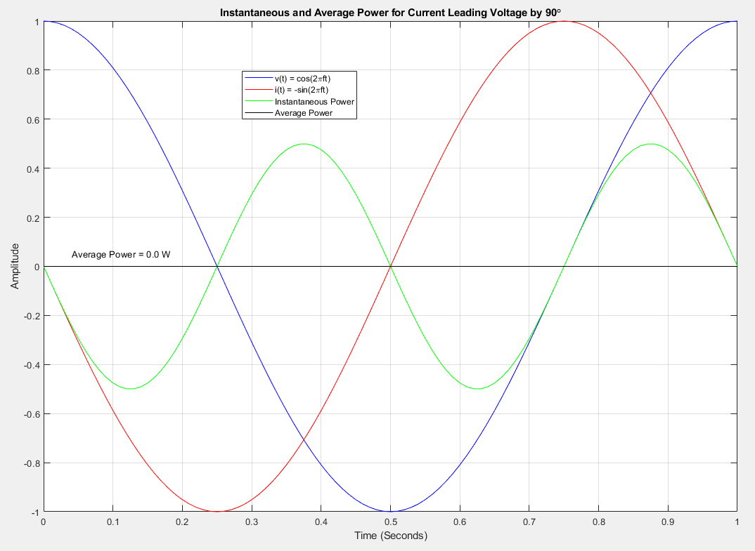
Instantaneous and Average Power (Continued)
$$p\left(t\right)=\frac{1}{2}V_{m}I_{m}\cos\left(θ_{v}−θ_{i}\right)+\frac{1}{2}V_{m}I_{m}cos\left(4πft+θ_{v}+θ_{i}\right). P=\frac{1}{2}V_{m}I_{m}\cos\left(θ_{v}−θ_{i}\right).$$
Poll Questions

Slide 9
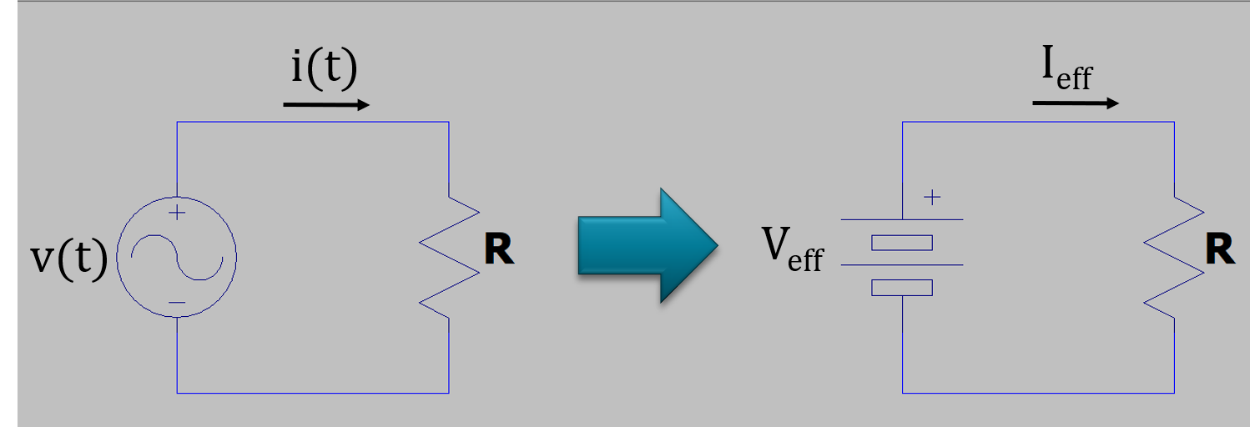
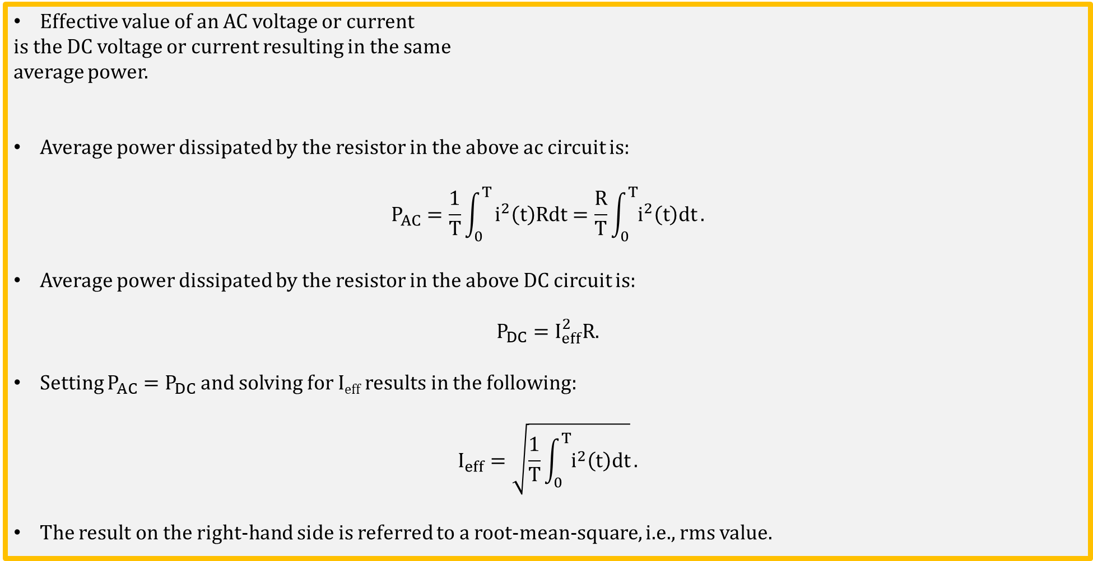
Effective Value of AC Voltage or Current
Effective value of an AC voltage or current
is the DC voltage or current resulting in the same
average power.
Average power dissipated by the resistor in the above ac circuit is:
$$P_{AC}=\frac{1}{T}\int_{0}^{T}{i^{2}\left(t\right)Rdt=\frac{R}{T}\int_{0}^{T}{i^{2}\left(t\right)dt}}.$$
Average power dissipated by the resistor in the above DC circuit is:
$$P_{DC}=I_{eff}^{2}R.$$
Setting $P_{AC}=P_{DC}$ and solving for I_{eff} results in the following:
$$I_{eff}=\sqrt{\frac{1}{T}\int_{0}^{T}{i^{2}\left(t\right)dt}}.$$
The result on the right-hand side is referred to a root-mean-square, i.e., rms value.

Slide 10
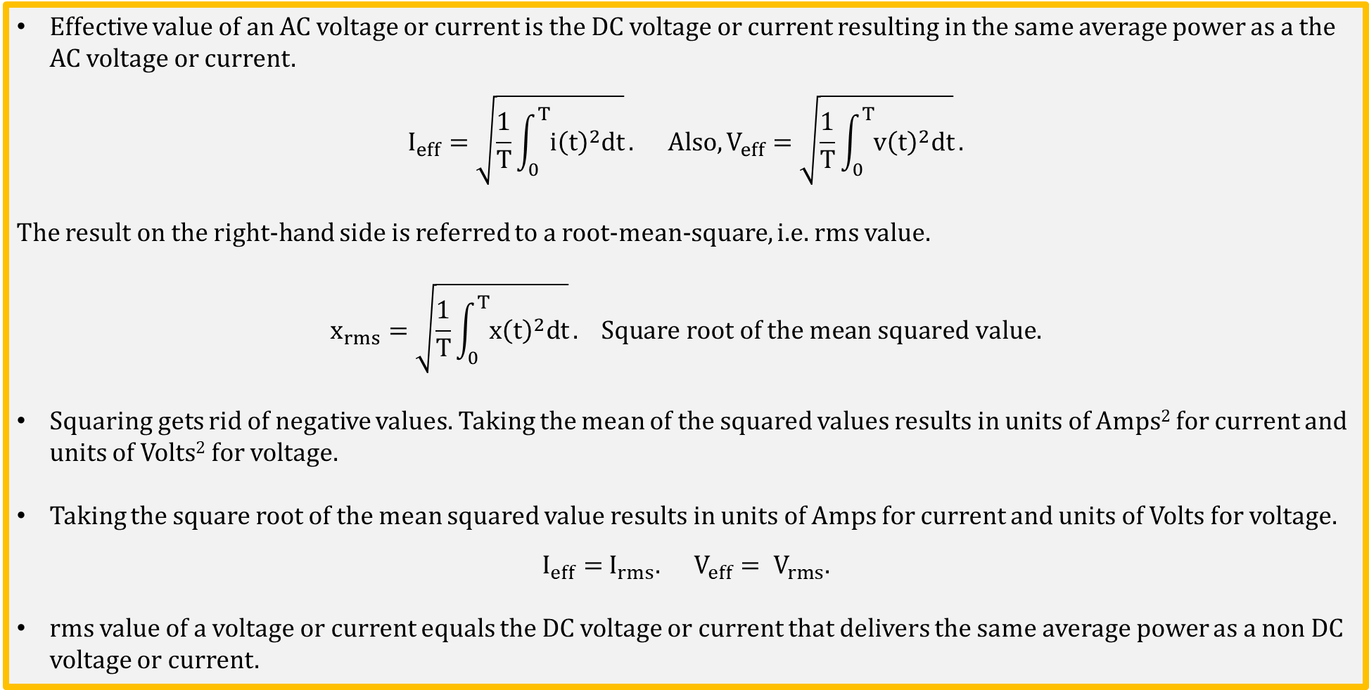
Effective and rms Value
Effective value of an AC voltage or current is the DC voltage or current resulting in the same average power as a the AC voltage or current.
$$I_{eff}=\sqrt{\frac{1}{T}\int_{0}^{T}{{i\left(t\right)}^{2}dt}}. Also, V_{eff}=\sqrt{\frac{1}{T}\int_{0}^{T}{{v\left(t\right)}^{2}dt}}.$$
The result on the right-hand side is referred to a root-mean-square, i.e. rms value.
$$x_{rms}=\sqrt{\frac{1}{T}\int_{0}^{T}{{x\left(t\right)}^{2}dt}}. Square root of the mean squared value.$$
Squaring gets rid of negative values. Taking the mean of the squared values results in units of Amps² for current and units of Volts² for voltage.
Taking the square root of the mean squared value results in units of Amps for current and units of Volts for voltage.
$I_{eff}=$ $I_{rms}. V_{eff}= V_{rms}.$
rms value of a voltage or current equals the DC voltage or current that delivers the same average power as a non DC voltage or current.

Slide 11
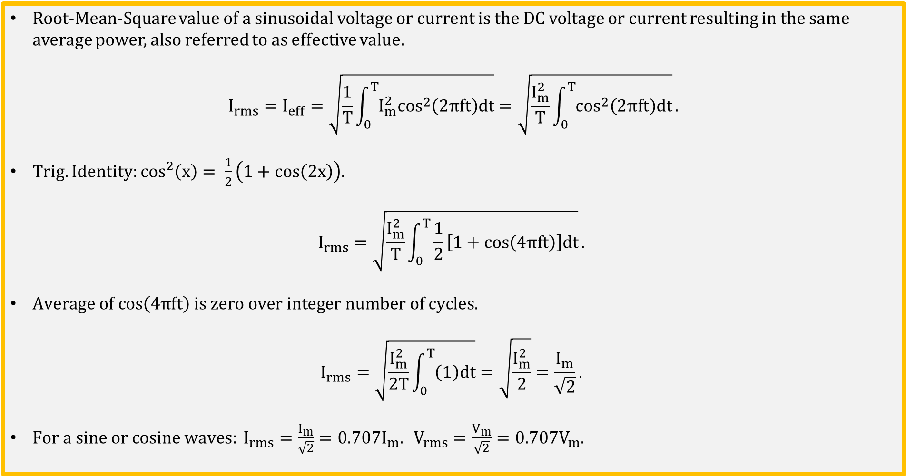
rms Value of a Sine or Cosine Wave
Root-Mean-Square value of a sinusoidal voltage or current is the DC voltage or current resulting in the same average power, also referred to as effective value.
$$I_{rms}=I_{eff}=\sqrt{\frac{1}{T}\int_{0}^{T}{I_{m}^{2}\cos^{2}\left(2πft\right)dt}}=\sqrt{\frac{I_{m}^{2}}{T}\int_{0}^{T}{\cos^{2}\left(2πft\right)dt}}.$$
Trig. Identity: $\cos^{2}\left(x\right)= \frac{1}{2}\left(1+cos\left(2x\right)\right).$
$$I_{rms}=\sqrt{\frac{I_{m}^{2}}{T}\int_{0}^{T}{\frac{1}{2}\left[1+cos\left(4πft\right)\right]dt}}.$$
$Average of cos\left(4πft\right) is zero over integer number of cycles.$
$$I_{rms}=\sqrt{\frac{I_{m}^{2}}{2T}\int_{0}^{T}{\left(1\right)dt}}=\sqrt{\frac{I_{m}^{2}}{2}}=\frac{I_{m}}{\sqrt{2}}.$$
$For a sine or cosine waves: I_{rms}=\frac{I_{m}}{\sqrt{2}}=0.707I_{m}. V_{rms}=\frac{V_{m}}{\sqrt{2}}=0.707V_{m}.$

Slide 12
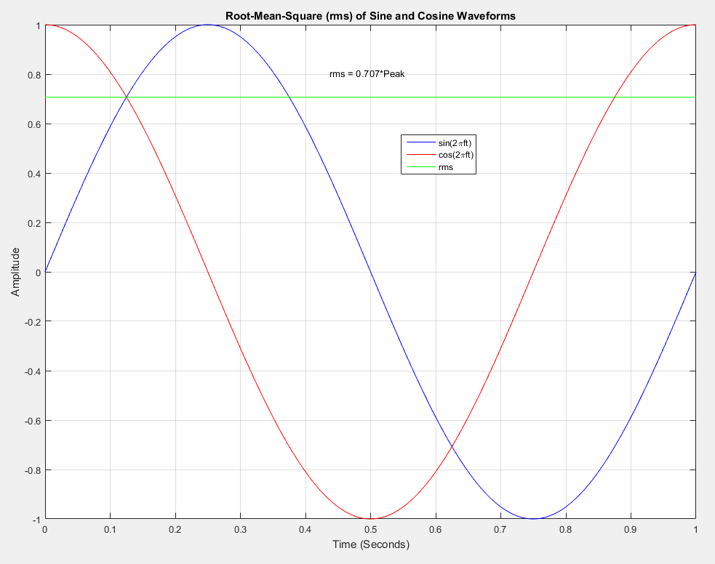
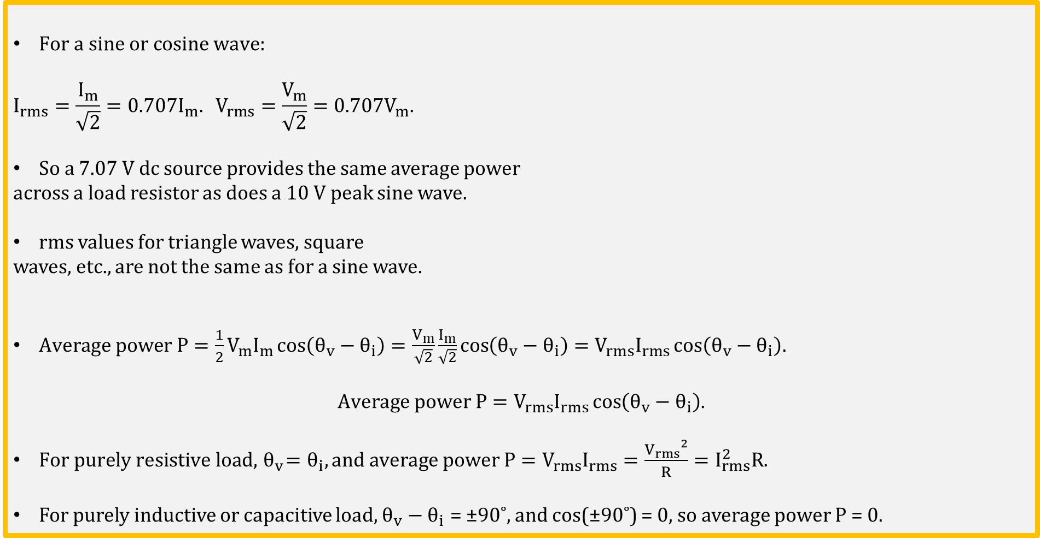
rms Value of a Sine or Cosine Wave (Continued)
$For a sine or cosine wave:$
$$I_{rms}=\frac{I_{m}}{\sqrt{2}}=0.707I_{m}. V_{rms}=\frac{V_{m}}{\sqrt{2}}=0.707V_{m}.$$
So a 7.07 V dc source provides the same average power
across a load resistor as does a 10 V peak sine wave.
rms values for triangle waves, square
waves, etc., are not the same as for a sine wave.
$Average power P=\frac{1}{2}V_{m}I_{m}\cos\left(θ_{v}−θ_{i}\right)=\frac{V_{m}}{\sqrt{2}}\frac{I_{m}}{\sqrt{2}}cos\left(θ_{v}−θ_{i}\right)=V_{rms}I_{rms}\cos\left(θ_{v}−θ_{i}\right).$
$$Average power P=V_{rms}I_{rms}\cos\left(θ_{v}−θ_{i}\right).$$
$For purely resistive load,{ θ}_{v}=θ_{i}, and average power P=V_{rms}I_{rms}=\frac{{V_{rms}}^{2}}{R}=I_{rms}^{2}R.$
For purely inductive or capacitive load, $θ_{v}−θ_{i}$ = ±90˚, and cos(±90˚) = 0, so average power $P$= 0.

Slide 13
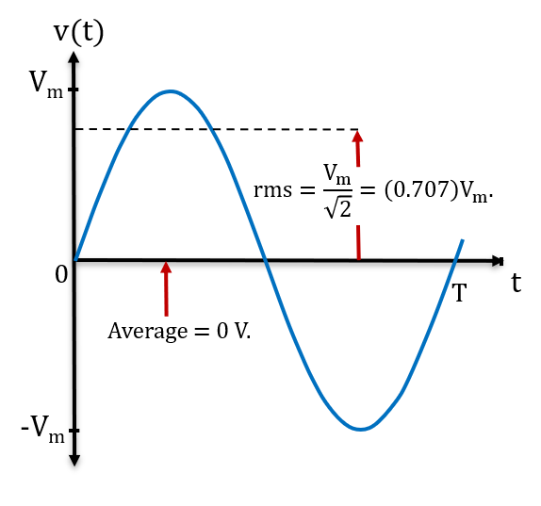
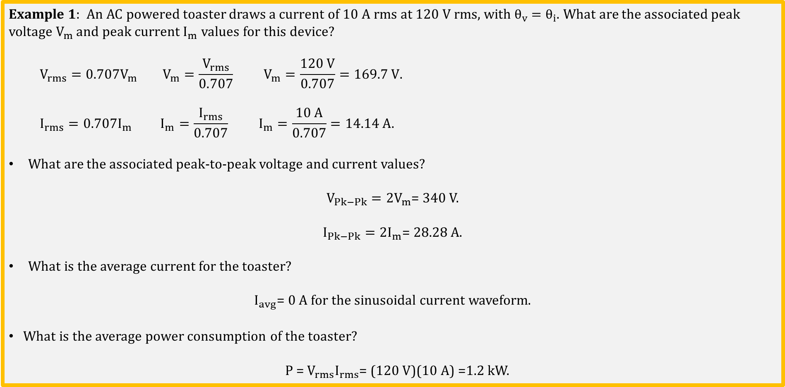
Average and rms Example 1
Example 1: An AC powered toaster draws a current of 10 A rms at 120 V rms, with${ θ}_{v} =θ_{i}$. What are the associated peak voltage $V_{m}$ and peak current $I_{m}$ values for this device?
$$V_{rms}=0.707V_{m} V_{m}=\frac{V_{rms}}{0.707} V_{m}=\frac{120 V}{0.707}=169.7 V.$$
$$I_{rms}=0.707I_{m} I_{m}=\frac{I_{rms}}{0.707} I_{m}=\frac{10 A}{0.707}=14.14 A.$$
What are the associated peak-to-peak voltage and current values?
$V_{Pk−Pk}=2V_{m}$= 340 V.
$I_{Pk−Pk}=2I_{m}$= 28.28 A.
What is the average current for the toaster?
$I_{avg}$= 0 A for the sinusoidal current waveform.
What is the average power consumption of the toaster?
P = $V_{rms}I_{rms}$= (120 V)(10 A) =1.2 kW.

Slide 14
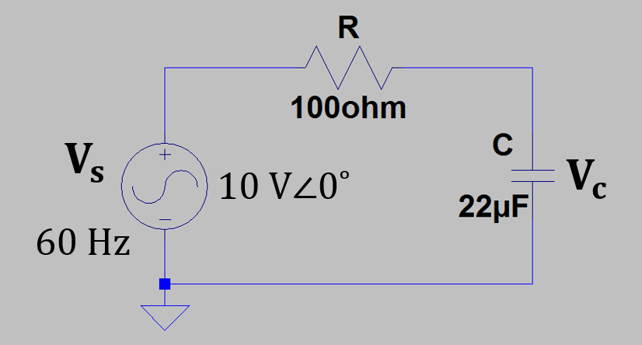
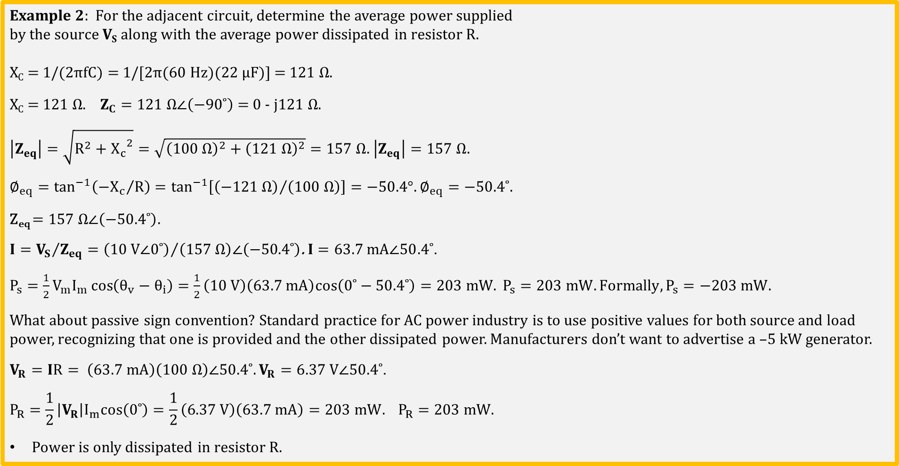
Average and rms Example 2
Example 2: For the adjacent circuit, determine the average power supplied
by the source V_{S} along with the average power dissipated in resistor R.
X_{C} = 1/(2πfC) = 1/[2π(60 Hz)(22 µF)] = 121 Ω.
X_{C} = 121 Ω. $Z_{C}=121 Ω∠\left(−90˚\right)$ = 0 - j$121 Ω$.
$\left|Z_{eq}\right|=\sqrt{R^{2}+{X_{c}}^{2}}=\sqrt{{\left(100 Ω\right)}^{2}+{\left(121 Ω\right)}^{2}}=157 Ω$. $\left|Z_{eq}\right|=157 Ω$.
$∅_{eq}=\tan^{−1}\left({{−X}_{c}}/R\right)=\tan^{−1}\left[{\left(−121 Ω\right)}/{\left(100 Ω\right)}\right]=−50.4°.∅_{eq}=−50.4˚$.
Z_{eq} $=157 Ω∠\left(−50.4˚\right)$.
$I={V_{S}}/{Z_{eq}}={\left(10 V∠0˚\right)}/{\left(157 Ω\right)∠\left(−50.4˚\right)}$. $I=63.7 mA∠50.4˚$.
$P_{s}=\frac{1}{2}V_{m}I_{m}\cos\left(θ_{v}−θ_{i}\right)=\frac{1}{2}\left(10 V\right)\left(63.7 mA\right)cos\left(0˚−50.4˚\right)=203 mW. P_{s}=203 mW. Formally, P_{s}=−203 mW.$
What about passive sign convention? Standard practice for AC power industry is to use positive values for both source and load power, recognizing that one is provided and the other dissipated power. Manufacturers don’t want to advertise a –5 kW generator.
$V_{R}=IR= \left(63.7 mA\right)\left(100 Ω\right)∠50.4˚. V_{R}=6.37 V∠50.4˚$.
$$P_{R}=\frac{1}{2}\left|V_{R}\right|I_{m}cos\left(0˚\right)=\frac{1}{2}\left(6.37 V\right)\left(63.7 mA\right)=203 mW. P_{R}=203 mW.$$
Power is only dissipated in resistor R.

Slide 15
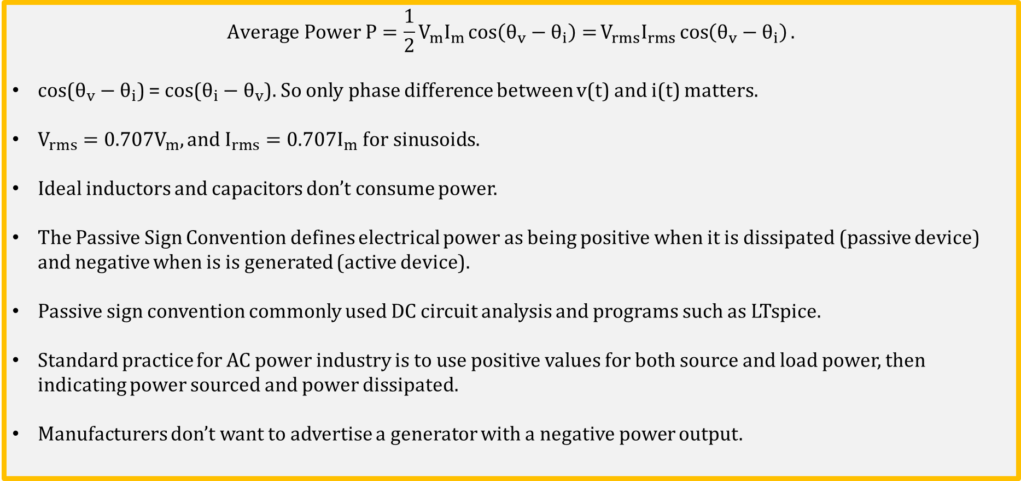
Average Power Summary
$$Average Power P=\frac{1}{2}V_{m}I_{m}\cos\left(θ_{v}−θ_{i}\right)=V_{rms}I_{rms}\cos\left(θ_{v}−θ_{i}\right).$$
cos($θ_{v}−θ_{i}$) = cos($θ_{i}−θ_{v}$). So only phase difference between v(t) and i(t) matters.
$V_{rms}=0.707V_{m}, and{ I}_{rms}=0.707I_{m} for sinusoids.$
Ideal inductors and capacitors don’t consume power.
The Passive Sign Convention defines electrical power as being positive when it is dissipated (passive device) and negative when is is generated (active device).
Passive sign convention commonly used DC circuit analysis and programs such as LTspice.
Standard practice for AC power industry is to use positive values for both source and load power, then indicating power sourced and power dissipated.
Manufacturers don’t want to advertise a generator with a negative power output.

Slide 16
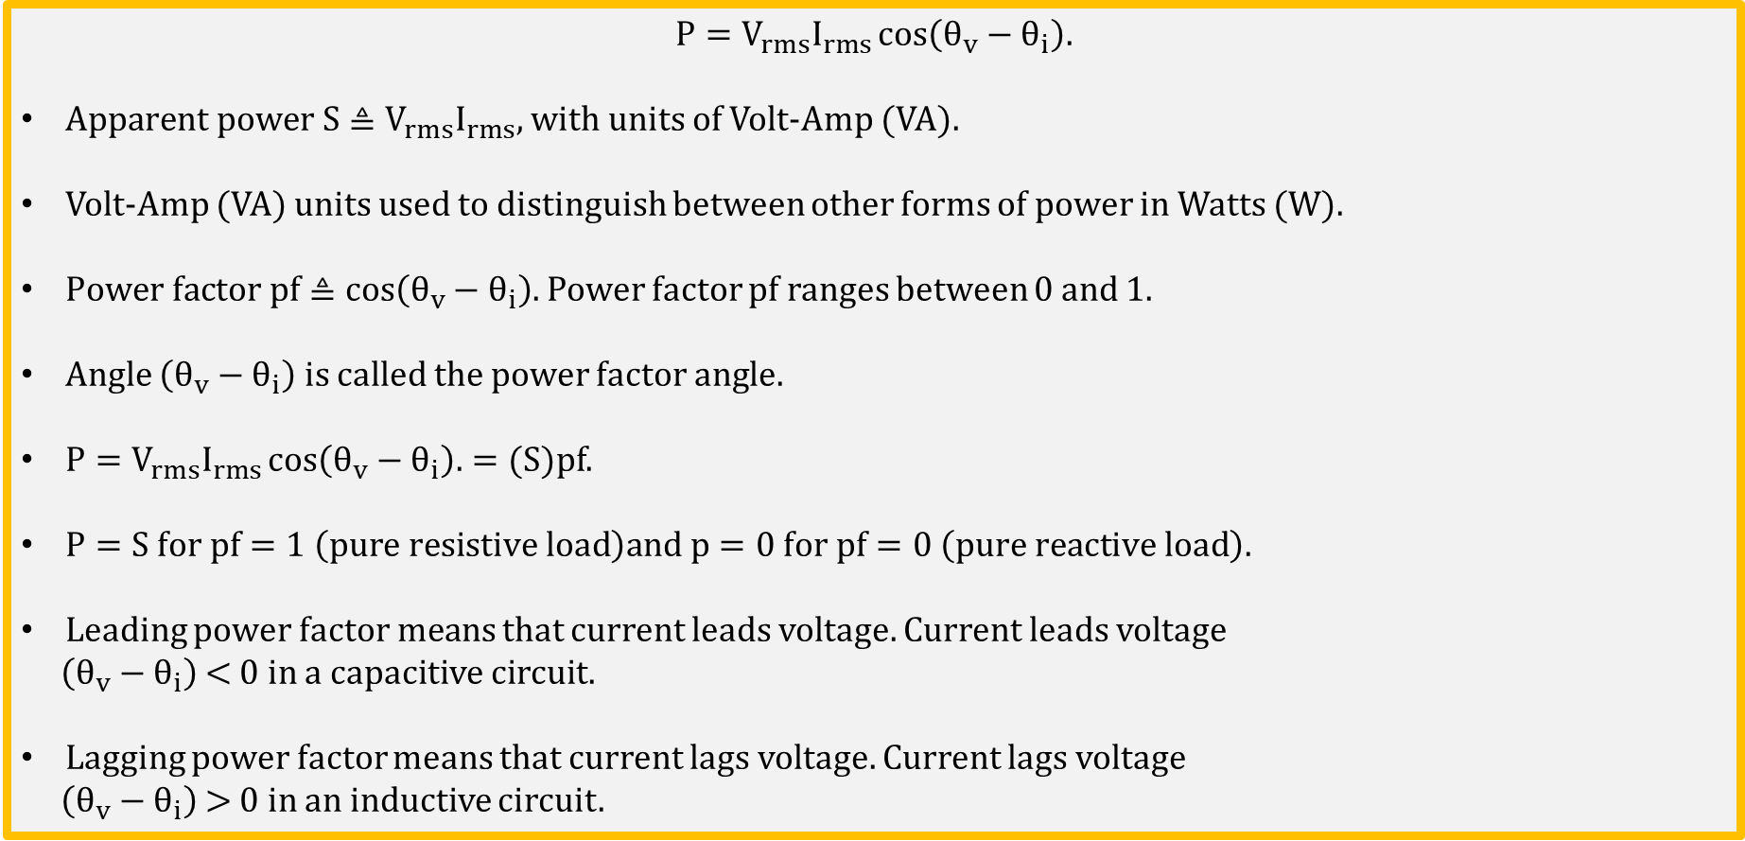
Apparent Power and Power Factor
$$P=V_{rms}I_{rms}\cos\left(θ_{v}−θ_{i}\right).$$
$Apparent power S≜V_{rms}I_{rms},$ with units of Volt-Amp (VA).
Volt-Amp (VA) units used to distinguish between other forms of power in Watts (W).
$Power factor pf≜\cos\left(θ_{v}−θ_{i}\right).$ Power factor pf ranges between 0 and 1.
Angle $\left(θ_{v}−θ_{i}\right)$ is called the power factor angle.
$P=V_{rms}I_{rms}\cos\left(θ_{v}−θ_{i}\right).=(S)pf$.
$P=S for pf=1 \left(pure resistive load\right)and p=0 for pf=0 \left(pure reactive load\right).$
Leading power factor means that current leads voltage. Current leads voltage
$\left(θ_{v}−θ_{i}\right)$ < 0 in a capacitive circuit.
Lagging power factor means that current lags voltage. Current lags voltage
$\left(θ_{v}−θ_{i}\right)$ > 0 in an inductive circuit.

Slide 17
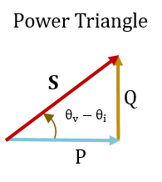
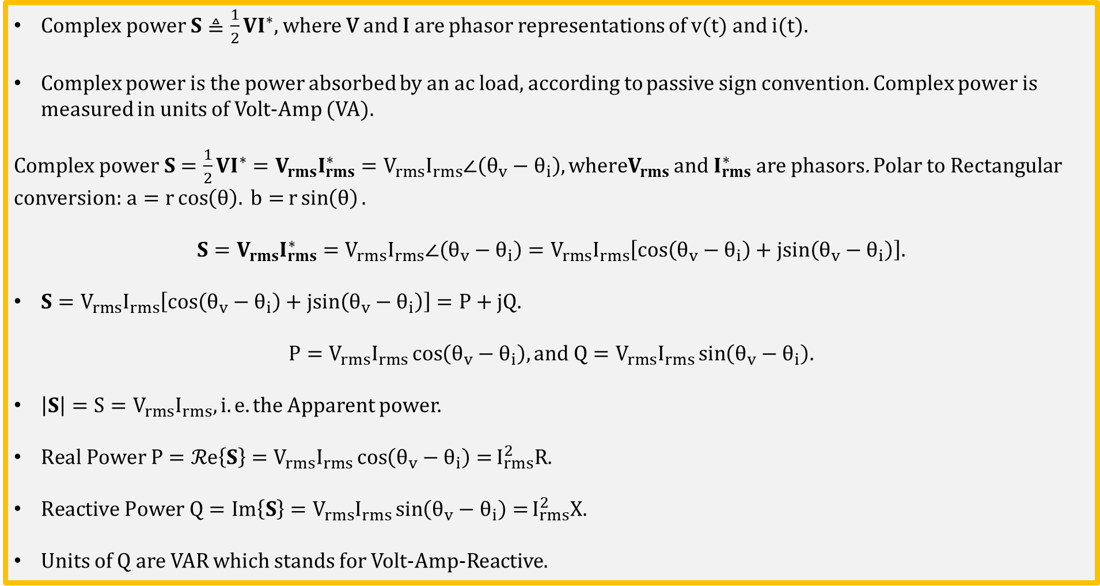
Complex Power
$Complex power S≜\frac{1}{2}VI^{∗},$ where V and I are phasor representations of v(t) and i(t).
Complex power is the power absorbed by an ac load, according to passive sign convention. Complex power is measured in units of Volt-Amp (VA).
$Complex power S=\frac{1}{2}VI^{∗}=V_{rms}I_{rms}^{∗}=V_{rms}I_{rms}∠\left(θ_{v}−θ_{i}\right), whereV_{rms}$ and $I_{rms}^{∗}$ are phasors. Polar to Rectangular conversion:$a=r\cos\left(θ\right). b=r\sin\left(θ\right).$
$$S=V_{rms}I_{rms}^{∗}=V_{rms}I_{rms}∠\left(θ_{v}−θ_{i}\right)=V_{rms}I_{rms}\left[cos\left(θ_{v}−θ_{i}\right)+jsin\left(θ_{v}−θ_{i}\right)\right].$$
$S=V_{rms}I_{rms}\left[cos\left(θ_{v}−θ_{i}\right)+jsin\left(θ_{v}−θ_{i}\right)\right]=P+jQ.$
$$P=V_{rms}I_{rms}\cos\left(θ_{v}−θ_{i}\right), and Q=V_{rms}I_{rms}\sin\left(θ_{v}−θ_{i}\right).$$
$\left|S\right|=S=V_{rms}I_{rms}, i.e. the$ Apparent power.
$Real Power P=ℛe\left\{S\right\}=V_{rms}I_{rms}\cos\left(θ_{v}−θ_{i}\right)=I_{rms}^{2}R.$
$Reactive Power Q=Im\left\{S\right\}=V_{rms}I_{rms}\sin\left(θ_{v}−θ_{i}\right)=I_{rms}^{2}X.$
Units of Q are VAR which stands for Volt-Amp-Reactive.

Slide 18
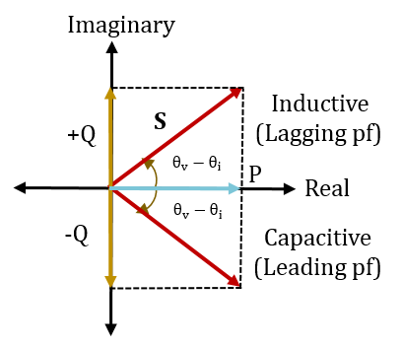
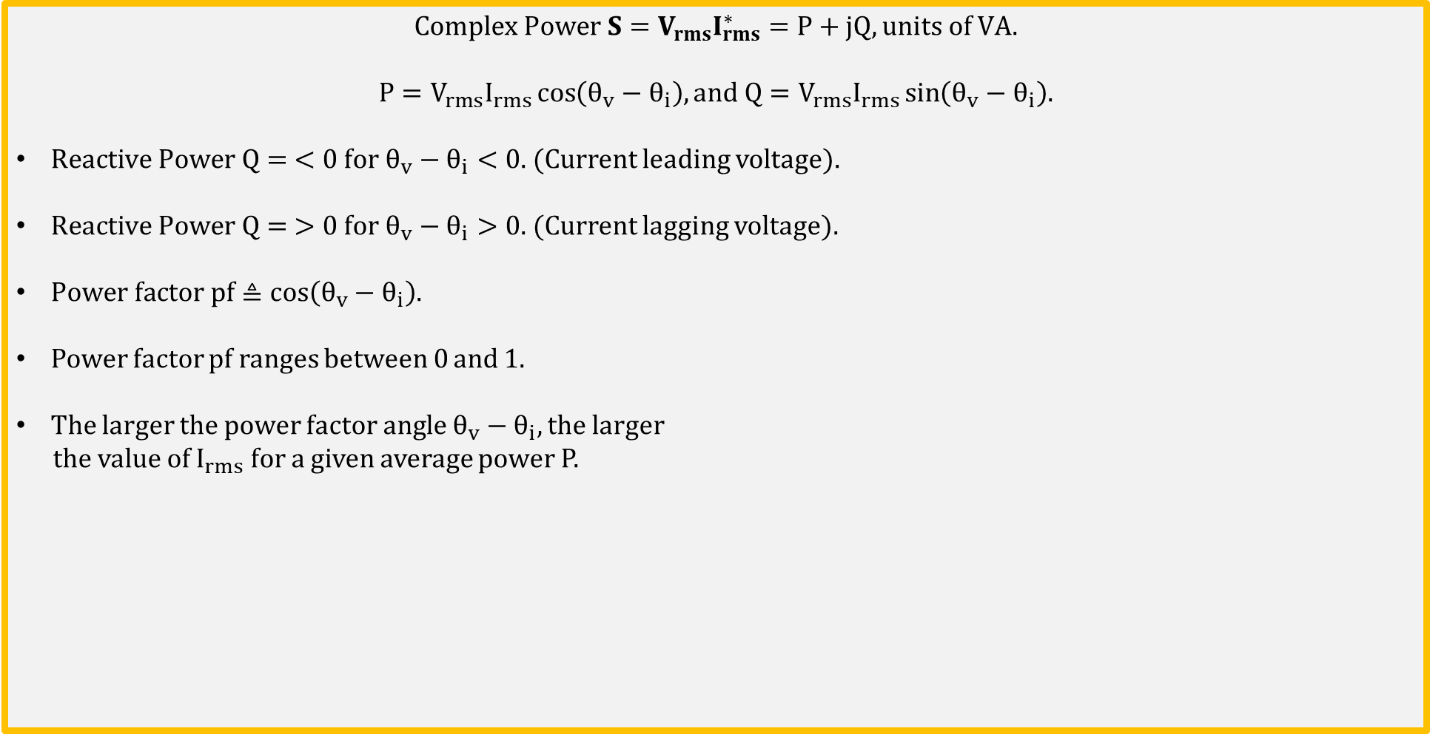
Complex Power (Continued)
$$Complex Power S=V_{rms}I_{rms}^{∗}=P+jQ, units of VA.$$
$$P=V_{rms}I_{rms}\cos\left(θ_{v}−θ_{i}\right), and Q=V_{rms}I_{rms}\sin\left(θ_{v}−θ_{i}\right).$$
$Reactive Power Q= <0 for θ_{v}−θ_{i}<0.$ (Current leading voltage).
$Reactive Power Q= >0 for θ_{v}−θ_{i}>0.$ (Current lagging voltage).
$Power factor pf≜\cos\left(θ_{v}−θ_{i}\right).$
Power factor pf ranges between 0 and 1.
The larger the power factor angle $θ_{v}−θ_{i}$, the larger
the value of $I_{rms}$ for a given average power P.

Slide 19
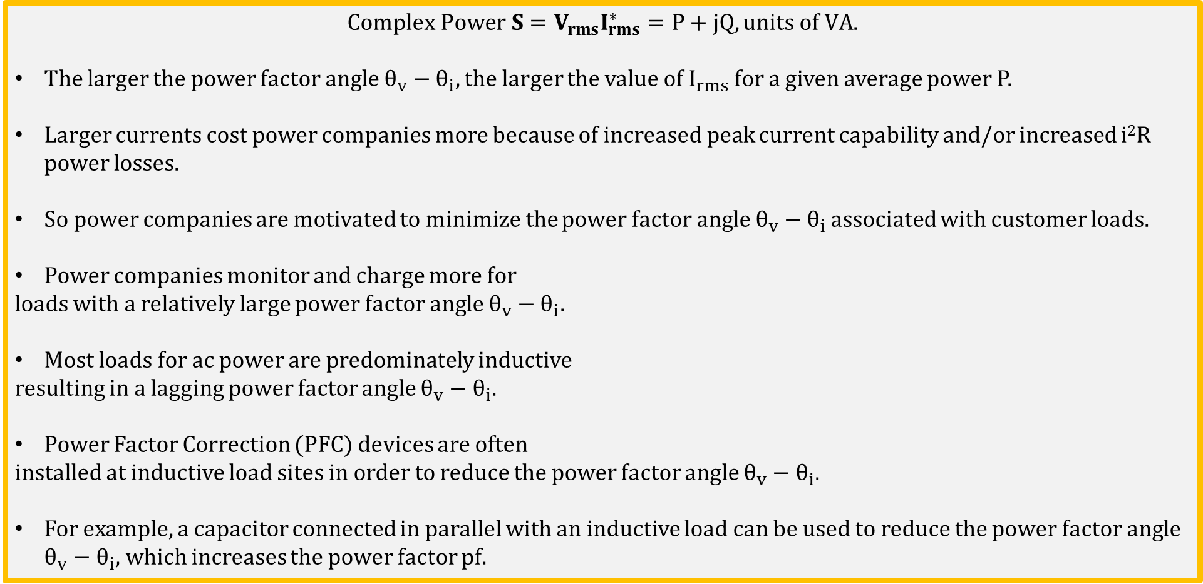
Power Factor Correction (PFC)
$$Complex Power S=V_{rms}I_{rms}^{∗}=P+jQ, units of VA.$$
The larger the power factor angle $θ_{v}−θ_{i}$, the larger the value of $I_{rms}$ for a given average power P.
Larger currents cost power companies more because of increased peak current capability and/or increased i²R power losses.
So power companies are motivated to minimize the power factor angle $θ_{v}−θ_{i}$ associated with customer loads.
Power companies monitor and charge more for
loads with a relatively large power factor angle $θ_{v}−θ_{i}$.
Most loads for ac power are predominately inductive
resulting in a lagging power factor angle $θ_{v}−θ_{i}$.
Power Factor Correction (PFC) devices are often
installed at inductive load sites in order to reduce the power factor angle $θ_{v}−θ_{i}$.
For example, a capacitor connected in parallel with an inductive load can be used to reduce the power factor angle $θ_{v}−θ_{i}$, which increases the power factor pf.

Slide 20
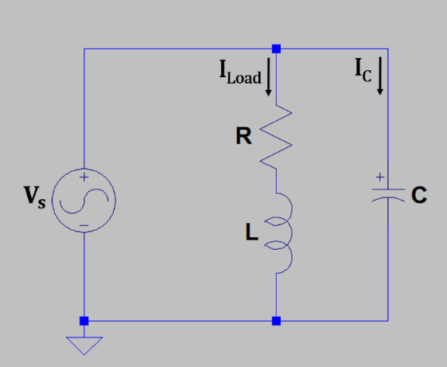
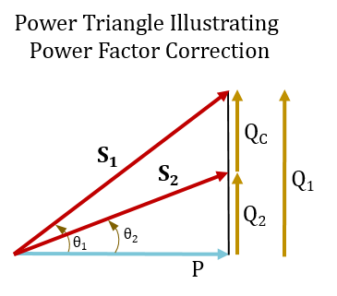
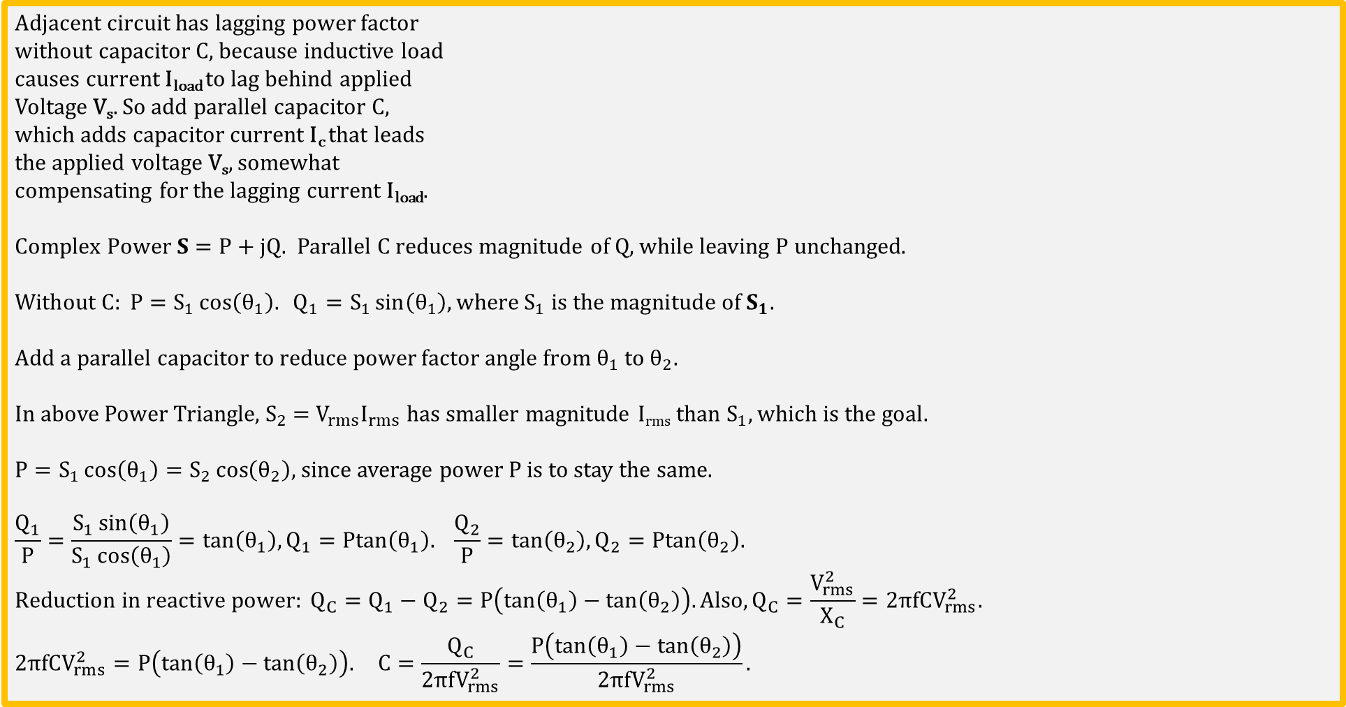
Power Factor Correction (PFC) (Continued)
Adjacent circuit has lagging power factor
without capacitor C, because inductive load
causes current I_{load} to lag behind applied
Voltage V_{s}. So add parallel capacitor C,
which adds capacitor current I_{c} that leads
the applied voltage V_{s}, somewhat
compensating for the lagging current I_{load}.
$Complex Power S=P+jQ.$ Parallel C reduces magnitude of Q, while leaving P unchanged.
$$Without C: P=S_{1}\cos\left(θ_{1}\right). Q_{1}=S_{1}\sin\left(θ_{1}\right), where S_{1} is the magnitude of S_{1}.$$
Add a parallel capacitor to reduce power factor angle from $θ_{1}$ to $θ_{2}.$
In above Power Triangle, $S_{2}$ = $V_{rms}I_{rms}$ has smaller magnitude I_{rms} than $S_{1}, which is the goal.$
$P=S_{1}\cos\left(θ_{1}\right)=S_{2}\cos\left(θ_{2}\right),$ since average power P is to stay the same.
$$\frac{Q_{1}}{P}=\frac{S_{1}\sin\left(θ_{1}\right)}{S_{1}\cos\left(θ_{1}\right)}=tan\left(θ_{1}\right),Q_{1}=Ptan\left(θ_{1}\right). \frac{Q_{2}}{P}=tan\left(θ_{2}\right),Q_{2}=Ptan\left(θ_{2}\right).$$
$$Reduction in reactive power: Q_{C}=Q_{1}−Q_{2}=P\left(tan\left(θ_{1}\right)−tan\left(θ_{2}\right)\right). Also,Q_{C}=\frac{V_{rms}^{2}}{X_{C}}=2πfCV_{rms}^{2}.$$
$$2πfCV_{rms}^{2}=P\left(tan\left(θ_{1}\right)−tan\left(θ_{2}\right)\right). C=\frac{Q_{C}}{2πfV_{rms}^{2}}=\frac{P\left(tan\left(θ_{1}\right)−tan\left(θ_{2}\right)\right)}{2πfV_{rms}^{2}}.$$

Slide 21

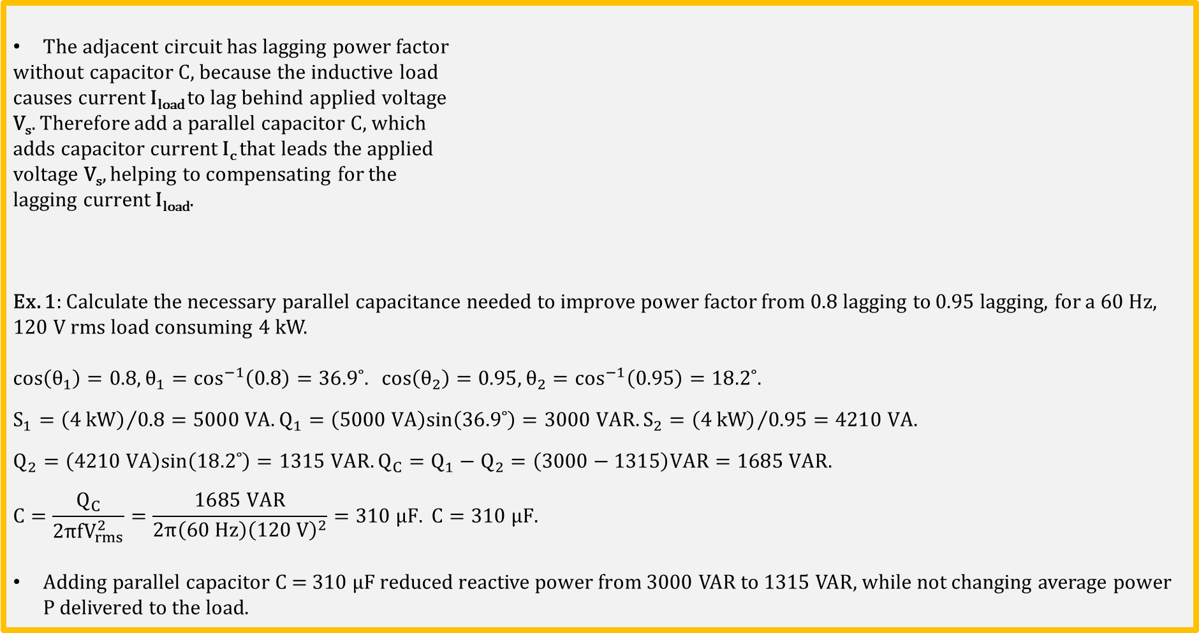
Power Factor Correction (PFC) (Continued)
The adjacent circuit has lagging power factor
without capacitor C, because the inductive load
causes current I_{load} to lag behind applied voltage
V_{s}. Therefore add a parallel capacitor C, which
adds capacitor current I_{c} that leads the applied
voltage V_{s}, helping to compensating for the
lagging current I_{load}.
Ex. 1: Calculate the necessary parallel capacitance needed to improve power factor from 0.8 lagging to 0.95 lagging, for a 60 Hz, 120 V rms load consuming 4 kW.
$$cos\left(θ_{1}\right)=0.8, θ_{1}=\cos^{−1}\left(0.8\right)=36.9˚. cos\left(θ_{2}\right)=0.95, θ_{2}=\cos^{−1}\left(0.95\right)=18.2˚.$$
$$S_{1}={\left(4 kW\right)}/{0.8}=5000 VA.Q_{1}=\left(5000 VA\right)sin\left(36.9˚\right)=3000 VAR. S_{2}={\left(4 kW\right)}/{0.95}=4210 VA.$$
$$Q_{2}=\left(4210 VA\right)sin\left(18.2˚\right)=1315 VAR.Q_{C}=Q_{1}−Q_{2}=\left(3000−1315\right)VAR=1685 VAR.$$
$$C=\frac{Q_{C}}{2πfV_{rms}^{2}}=\frac{1685 VAR}{2π\left(60 Hz\right){\left(120 V\right)}^{2}}=310 μF. C=310 μF.$$
Adding parallel capacitor C = 310 $μF$ reduced reactive power from 3000 VAR to 1315 VAR, while not changing average power P delivered to the load.

Slide 22
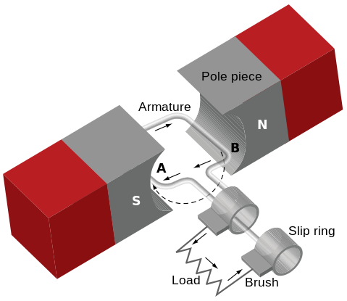
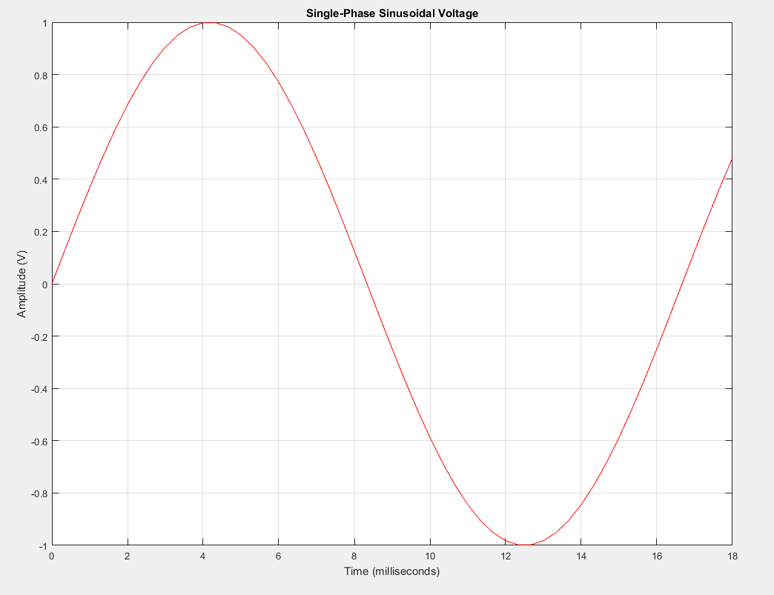
Single-Phase AC Generator
Single-phase AC generators, provide instantaneous power that goes to zero twice every cycle, which for US power is twice every (1/(60 Hz) = 16.7 ms. This results in undesirable vibration for large AC motors.
Notes:
Elementary Generator: https://commons.wikimedia.org/wiki/File:Elementary_generator.svg
Single-phase image created by CCD team of BYU-I.

Slide 23
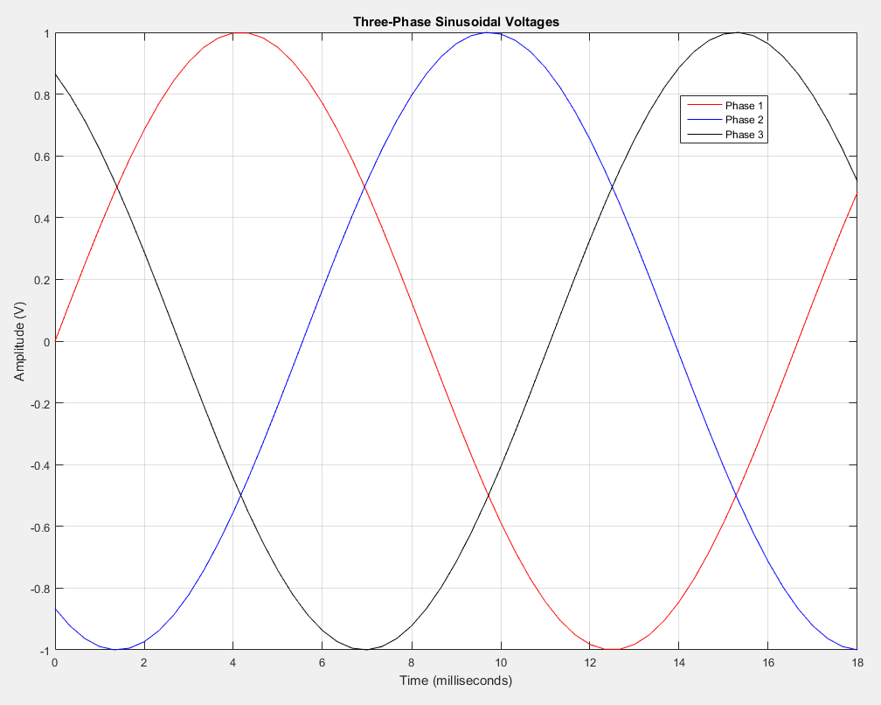
3 - Phase Power – 3 Separate Windings
3-phase power has 3 separate armatures spaced 360˚/3 = 120˚ apart, resulting in three sinusoidal voltages phased 120˚ apart. Resulting instantaneous power is never zero, which is preferred for large AC motors.

Slide 24

3 - Phase Power – (Continued)
To illustrate the difference between single-phase and 3-phase AC power, imagine a lone paddler in a canoe. The paddler can only exert a force that pushes the canoe along the water when the paddle is in the water. When the paddler lifts the paddle out of the water to prepare for the next stroke, the motional force from the paddler to the canoe is zero, resulting in a slowing of the canoe.
Now picture the same canoe with three paddlers. If their strokes are synchronized so each is separated 1/3 of a stroke cycle, the canoe receives more consistent motional force resulting in more consistent speed. A canoe utilizing 3-phase paddeling moves across the water more smoothly than for single phase paddling.
Notes:
Image from https://pixnio.com/sport/canoeing-and-kayaking-pictures/group-of-people-enjoying-a-canoe-tour

Slide 25
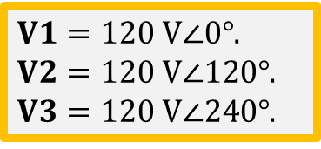
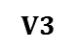
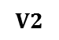
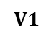
3-Phase AC Power
Most AC Power is Generated at 3-Phase Power. Three separate armature windings.
Less generator vibration.
Almost constant power output.
3-wire Delta (∆) configuration used for long-distance high-voltage transmission lines.
4-wire Wye (Y) configuration used for low-voltage distribution.
Three-phase Delta configuration (3 wires) actually requires about 25% less copper than single phase (2 wires) for the same power loss. (pg. 520). Hence three-phase delta is the preferred configuration for long distance power distribution.
Three-phase machines and controls can be smaller, lighter in weight, and more efficient than comparable single-phase equipment.
Phasor Diagram
Imaginary
$$V2$$
$V1=120 V∠0°$.
$V2=120 V∠120°$.
$V3=120 V∠240°$.
$$V1$$
Real
$$V3$$
Notes:
Three-phase y configuration image by CCD team of BYU-I.

Slide 26
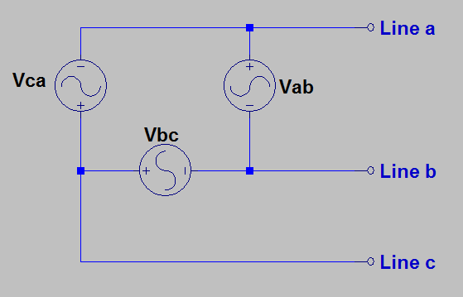
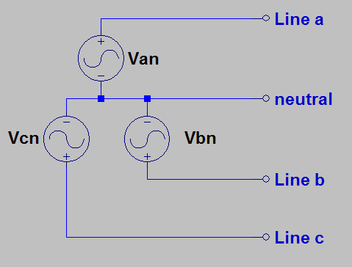
∆ and Y Connected Sources
3-Wire Delta(∆) configuration used for long-distance high-voltage power distribution.
4-wire Wye (Y) configuration used for low- voltage power distribution.
Notes:
https://commons.wikimedia.org/wiki/File:Electricity_grid_simple-_North_America.svg

Slide 27
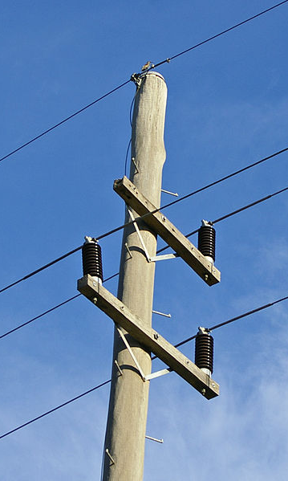
Low-Voltage 3-Phase Power
4-wire Wye (Y) configuration used for low-voltage power distribution.
Neutral wire at the top of the pole, also provides lightning protection.
Notes:
Three-phase y configuration image by CCD team of BYU-I.
Electrical pole: https://commons.wikimedia.org/wiki/File:Two_armed_power_pole_2.jpg

Slide 28
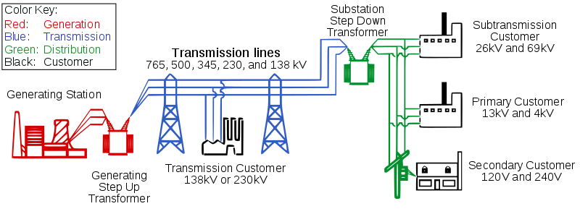
Typical AC Power Distribution
Notes:
https://commons.wikimedia.org/wiki/File:Electricity_grid_simple-_North_America.svg

Slide 29
Extra

Slide 30
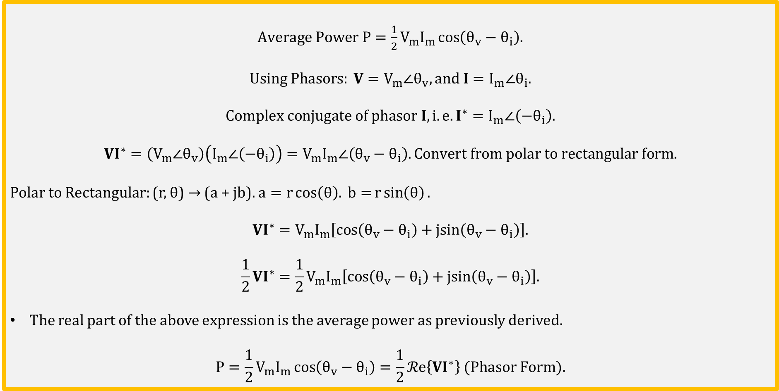
Average Power (Continued)
$Average Power P=\frac{1}{2}V_{m}I_{m}\cos\left(θ_{v}−θ_{i}\right).$
$$Using Phasors: V=V_{m}∠θ_{v}, and I=I_{m}∠θ_{i}.$$
$$Complex conjugate of phasor I, i.e. I^{∗}=I_{m}∠\left(−θ_{i}\right).$$
$$VI^{∗}=\left(V_{m}∠θ_{v}\right)\left(I_{m}∠\left(−θ_{i}\right)\right)=V_{m}I_{m}∠\left(θ_{v}−θ_{i}\right). Convert from polar to rectangular form.$$
Polar to Rectangular: (r, θ) → (a + jb). $a=r\cos\left(θ\right). b=r\sin\left(θ\right).$
$$VI^{∗}=V_{m}I_{m}\left[cos\left(θ_{v}−θ_{i}\right)+jsin\left(θ_{v}−θ_{i}\right)\right].$$
$$\frac{1}{2}VI^{∗}=\frac{1}{2}V_{m}I_{m}\left[cos\left(θ_{v}−θ_{i}\right)+jsin\left(θ_{v}−θ_{i}\right)\right].$$
The real part of the above expression is the average power as previously derived.
$$P=\frac{1}{2}V_{m}I_{m}\cos\left(θ_{v}−θ_{i}\right)=\frac{1}{2}ℛe\left\{VI^{∗}\right\} (Phasor Form).$$

Slide 31
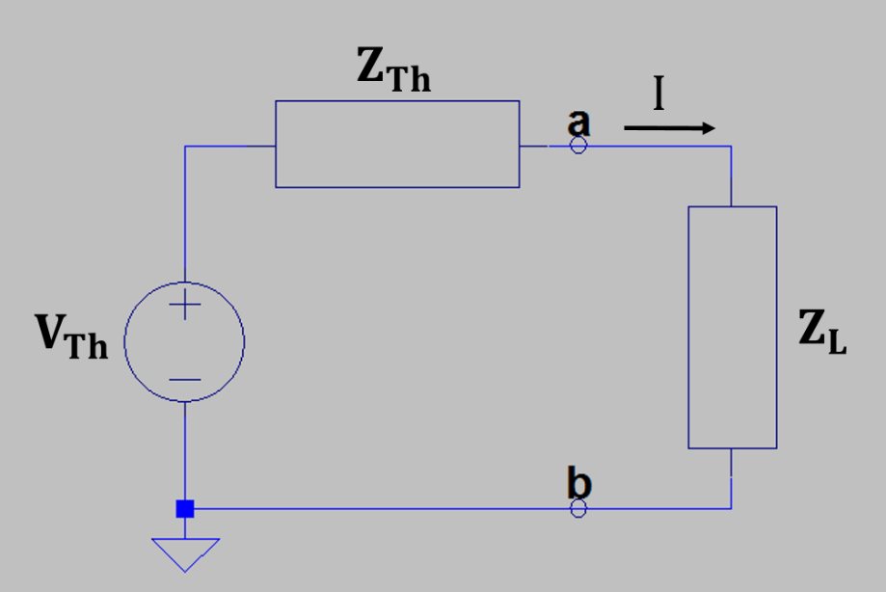
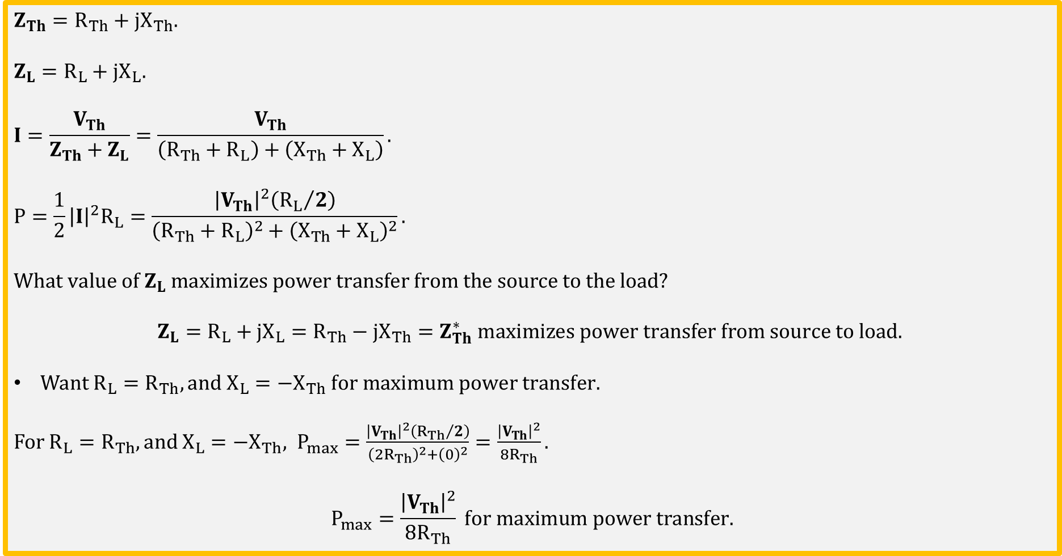
Maximum Average Power Transfer
$$Z_{Th}=R_{Th}+jX_{Th}.$$
$$Z_{L}=R_{L}+jX_{L}.$$
$$I=\frac{V_{Th}}{Z_{Th}+Z_{L}}=\frac{V_{Th}}{\left(R_{Th}+R_{L}\right)+\left(X_{Th}+X_{L}\right)}.$$
$$P=\frac{1}{2}{\left|I\right|}^{2}R_{L}=\frac{{\left|V_{Th}\right|}^{2}\left({R_{L}}/2\right)}{{\left(R_{Th}+R_{L}\right)}^{2}+{\left(X_{Th}+X_{L}\right)}^{2}}.$$
$$What value of Z_{L} maximizes power transfer from the source to the load?$$
$$Z_{L}=R_{L}+jX_{L}=R_{Th}−jX_{Th}=Z_{Th}^{∗} maximizes power transfer from source to load.$$
Want $R_{L}=R_{Th}, and{ X}_{L}=−X_{Th} for maximum power transfer.$
For $R_{L}=R_{Th}, and{ X}_{L}=−X_{Th}, P_{max}=\frac{{\left|V_{Th}\right|}^{2}\left({R_{Th}}/2\right)}{{\left({2R}_{Th}\right)}^{2}+{\left(0\right)}^{2}}=\frac{{\left|V_{Th}\right|}^{2}}{8R_{Th}}.$
$$P_{max}=\frac{{\left|V_{Th}\right|}^{2}}{8R_{Th}} for maximum power transfer.$$

